Slide 1
Experiment Three
FSK modem

Slide 2
First, the purpose of the experiment
1. Master the working principle and circuit composition of 2FSK modulation and demodulation.

Slide 3
Second, the content of the experiment
1. Observe the waveforms after modulation and demodulation of 2FSK, and record the waveforms after transmission and demodulation.

Slide 4
Third, Experimental instruments
Communication principle test box (FSK modem module);
Oscillograph.

Slide 5
Fourth, the principle of experiment
1. The basic principle of FSK (digital frequency modulation, frequency shift keying);
2. The basic principle of FSK modulation circuit/demodulation circuit.

Slide 6
1. The basic principle of FSK (Digital Frequency Modulation).
Digital frequency modulation, also known as frequency shift keying (FSK), uses carrier frequency changes to transmit digital information.
In binary digital modulation, a binary frequency-shift keying signal (2FSK signal) is generated if the frequency of the sinusoidal carrier changes with the binary baseband signal between f1 and f2 frequency points. The time waveform of the binary frequency-shift keying signal is shown in the figure below.

Slide 7
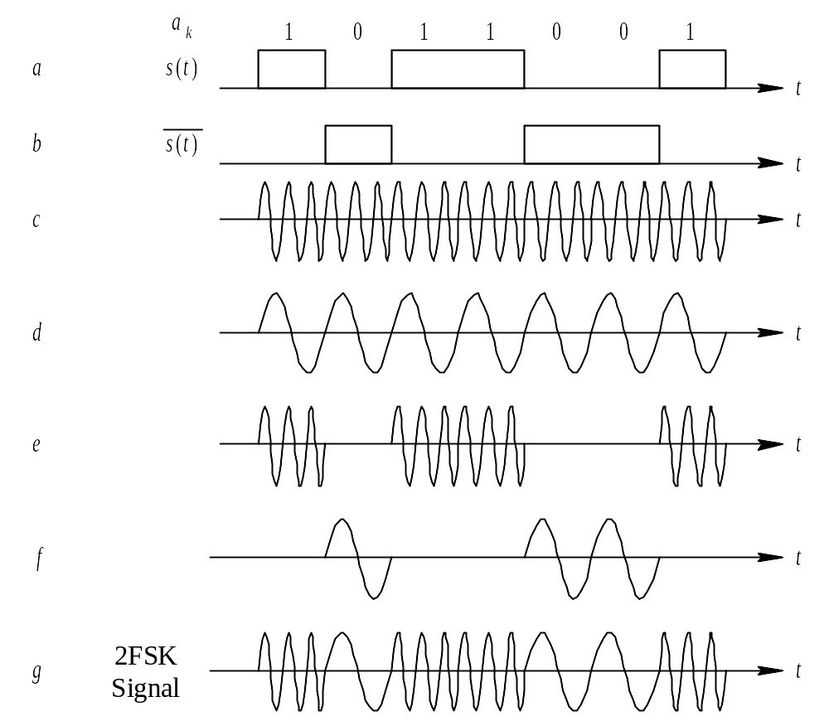
Figure 1 Time waveform of binary frequency-shift keying signal

Slide 8
In the diagram, the waveform g can be decomposed into waveform e and waveform f, i.e., the binary frequency-shift keying signal can be seen as the superposition of the binary amplitude keying signal of two different carriers. If the 1 symbol of the binary baseband signal corresponds to the carrier frequency f1, the 0 symbol corresponds to the carrier frequency f2.

Slide 9
2. The basic principle of FSK modulation circuit
The block diagram of the FSK modulation and demodulation electrical principle is shown in Figure 2, and Figure 3 is the electrical schematic diagram of its modulation circuit.
The input baseband signal is divided into two channels after being transferred by the transfer switch K904, one to control the carrier frequency of f1=32KHz, and the other to control the carrier frequency of f2=16KHz through inverted phase. When the baseband signal is “1”, the analog switch 1 is turned on, the analog switch 2 is closed, the output f1=32KHz is at this time, when the baseband signal is “0”, the analog switch 1 is closed, and the analog switch 2 is turned on. At this time, the output f2=16KHz, so the adjusted FSK signal can be obtained at the output.

Slide 10
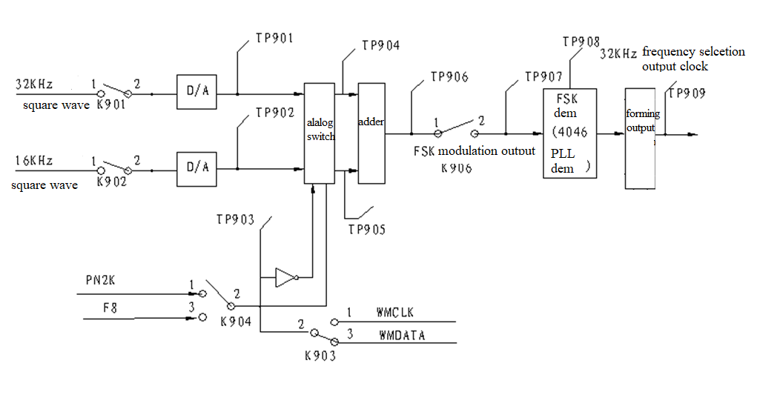
Fig2 FSK modulation/demodulation principle

Slide 11
Fifth, Experimental procedures
Test the waveforms of each measurement point of FSK modulation and demodulation circuit TP901~TP909 and analyze:
1) Press the key switches: K01, K02, K900;
2) Jumper switch setting: K901, K902, K904 (2KHz pseudo-random code, code sequence: 000011101100101), K904 (8KHz square wave). FSK demodulation experiment, K904 and K903.

Slide 12
3) Plug in the capacitor in CA901 and adjust the potentiometer W903 or W904 to make the voltage controlled oscillator work at about 16KHz;
4) Turn on the switch K906, input the FSK signal to the demodulation circuit, and pay attention to the number of carriers contained in the "1" and "0" codes.
5) Observe the FSK demodulation output TP907~TP909 waveform, and make a record, and observe the baseband signal at the FSK modulation end at the same time, compare the two waveforms, and observe whether there is distortion.

Slide 13
Note: During FSK demodulation, the K904 can only be connected by toggle upwards, that is, the 000011101100101 code with a code rate of 2KHz is demodulated. K904 can not be connected by toggle down, otherwise the FSK demodulation circuit can not demodulate the digital baseband signal at this time, because F = 8KHz, fc2 = 16KHz at this time, so it does not meet the relationship between 4F ≤ fc1, because their spectrum overlaps at this time. Therefore, after this experiment is completed, attention should be paid to setting the switch K904 to the position of toggle upwards to connect it.

Slide 14
Description of each measurement point
TP901: 32KHz carrier frequency signal, toggled down by K901, adjustable potentiometer W901 change amplitude.
TP902: 16KHz carrier frequency signal, toggled down by K902, can adjust the amplitude of potentiometer W902.
TP903: As F=2KHz or 8KHz digital baseband signal input, determined by switch K904. On K904: 000011101100101 code with a code rate of 2KHz; Under K904: 10101010 code with a symbol rate of 8KHz.
TP904: 32KHz baseband FSK modulated signal output.
TP905: 16KHz baseband FSK modulation signal output.

Slide 15
TP906: FSK modulation signal is output after superposition, and is controlled by input switch K905 when sent to FSK demodulation circuit;
TP907: FSK demodulation signal input. The input switch K906 of the FSK demodulation circuit is toggled downward;
TP908: The working clock of FSK demodulation circuit should be about 32KHz during normal operation, and the frequency deviation should not be greater than 2KHz;
TP909: FSK demodulation signal output, that is, digital baseband signal output, the waveform is the same as TP905.
Note: During FSK demodulation, the K904 can only be toggled upward, that is, the 000011101100101 code with a code rate of 2KHz is demodulated.

Slide 16
Experimental Requirements:
When K904 is toggled down (input TP903 is a square wave), observe the TP901-906 waveform;
When K904 is toggled upwards (the input is not a square wave), observe the TP901-909 waveform; and record the TP903 and TP909 waveforms (the input and demodulated waveforms are just the opposite).

Slide 17
Sixth, Experimental report
First, the purpose of the experiment
100110101111000
Draw the FSK waveform
Second, the content of the experiment
Third, Experimental instruments
Fourth, the principle of experiment
Fifth, Experimental procedures
Sixth, the results of the experiment

